Slide 1
Idaho Geospatial Council – Executive Committee
(IGC-EC)
March 19, 2020

Slide 2
Minutes
January 16, 2020

Slide 3
Geodetic Control
Technical Working Group
GC-TWG
Chair: Keith T Weber, GISP
ISU GIS TReC

Slide 4
NATRF2022
Two spatial reference system changes for Idaho
Each is referred to as a LAYER by NGS
LAYER 1 is a revision of IDTM
LAYER 2 is a revision of SPCS

Slide 5
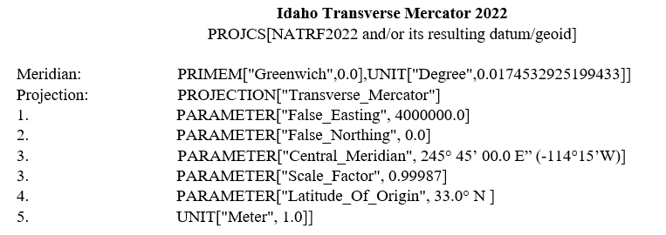
LAYER 1
Previously discussed at IGC-EC

Slide 6
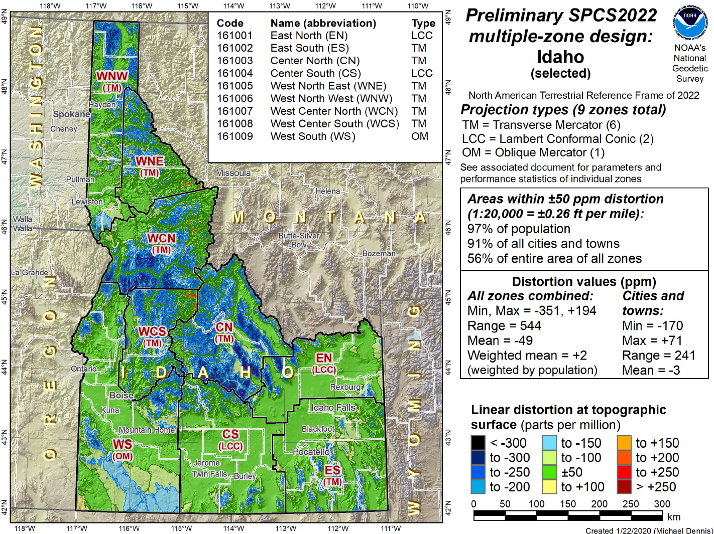
LAYER 2

Slide 7
Consensus
GC-TWG recommends adopting NATRF2022
  LAYER 1 for statewide GIS
  LAYER 2 for survey, engineering, and other applications
How would IGC-EC like to proceed?
  LAYER 1 was sent to IGC general membership on October 2nd, 2019.

Slide 8
Questions?
mcpd@isu.edu
webekeit@isu.edu
giscenter@isu.edu

Slide 9
TWG Update
Public Safety

Slide 10
Other Business
2020 IGC-EC Election Results

Slide 11
2020 IGC-EC Election Results
Position | Elected Members
State (Seat 1) | Sydney Lewis, Idaho Transportation Department (I)
Federal (Seat 4) | Carolina Valderrama-Echavarria, U.S. Census
Local (Seat 6) | Betty Conces, Kootenai County (I)
Local (Seat 7) | Kelly Green, Blaine County (I)
Tribal (Seat 8) | Laurie Ames, Nez Perce Tribe (I)
Private (Seat 10) | Jan Cunningham, Esri
(I) = Incumbent

Slide 12
Other Business
ITA and Subcommittee Ethics and Code of Conduct Policy

Slide 13
Adjourn
Next Meeting:
  IGC-EC Meeting - Thursday, May 21, 2020

