Slide 1
Idaho Geospatial Council – Executive Committee
(IGC-EC)
May 21, 2020

Slide 2
Minutes
March 19, 2020

Slide 3
2020 Census Update
Partnership Specialist, Carolina Valderrama Echavarria
5/21/2020

Slide 4
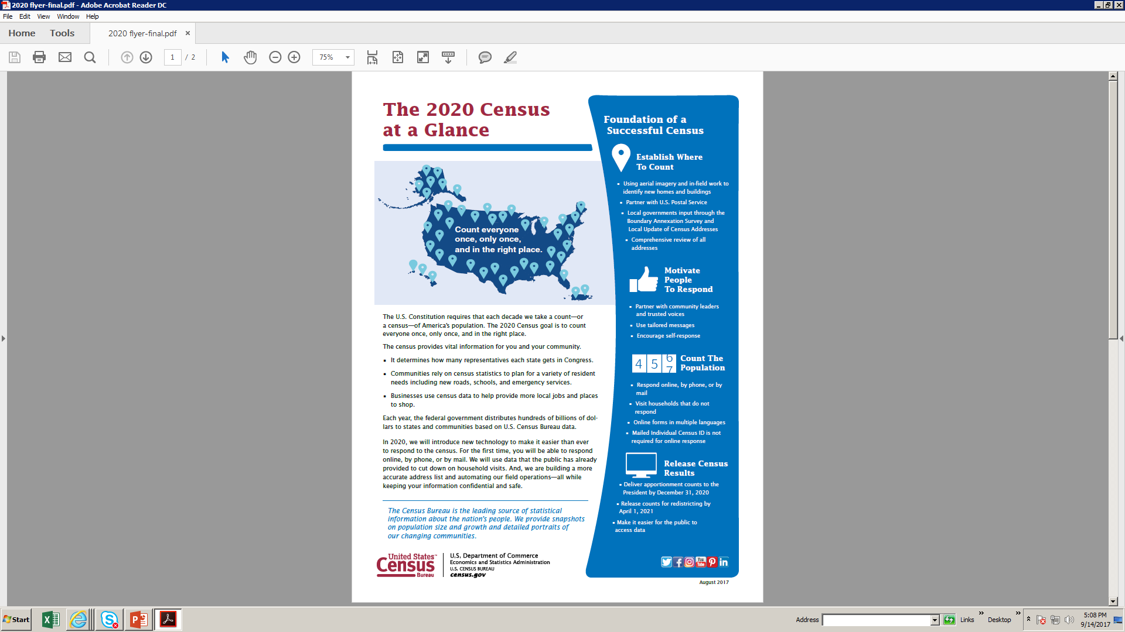
2020 Census

Slide 5



Self Response
The U.S. Census Bureau is monitoring coronavirus (COVID-19) carefully, and the health, safety and well-being of the public and our staff is our top priority.
Self-Response Phase – Revised Schedule March 12 – October 31
Group Quarters (E-Response & Paper Enumeration) April 2 – September 3
https://2020census.gov/en/news-events/operational-adjustments-covid-19.html

Slide 6
Update Leave (UL)
Boise Area Census Office (ACO) opened and operation began: May 4th
Idaho 63.5 % complete (as of May14th)
Boise (ACO) - to begin UL in Mountain Home Airforce base
UL to start in Idaho’s largest UL areas: Blaine, Freemont, and Valley
Shoshone/Bannock Tribes start UL May 18th
Quality Control for UL is 56% (verification that the address where UL packet was left was correctly entered into system.)
UL Packets are dropped off at households, no direct person to person contact

Slide 7
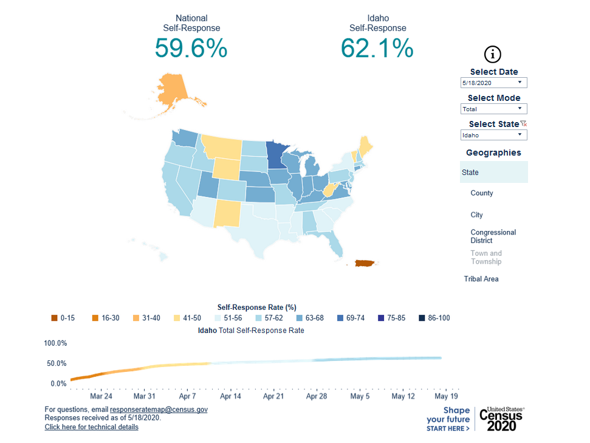

Slide 8
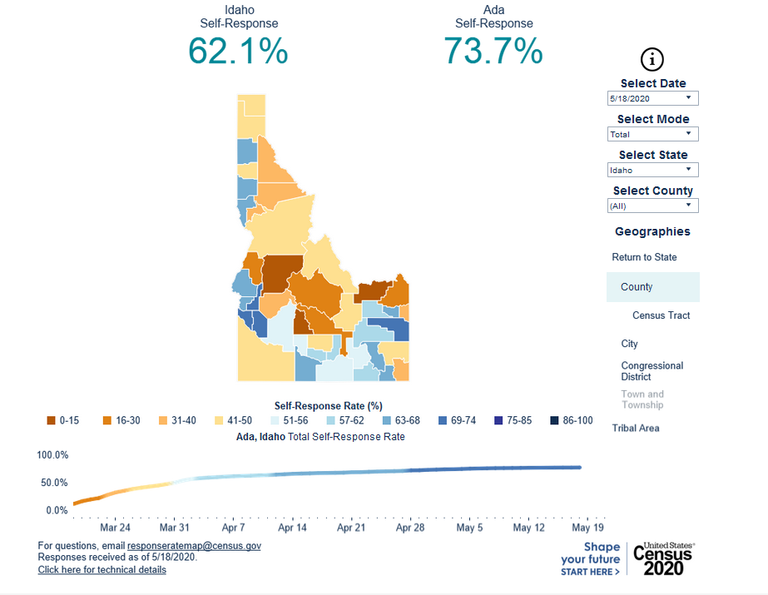

Slide 9
Why does it matter?
Power
Congressional representation
Reapportionment & redistricting
Money
$675 billion distributed annually
Federal Funding distributed based on population
Idaho
In 2010 over $2.4 billion each year to the State
$1,473 approx. per Idahoan counted

Slide 10
Thank you!
Carolina Valderrama Echavarria
Carolina.valderrama.echava@2020census.gov
Resource map:
Go to 2020census.gov
click on “get the facts”,
then scroll down to “response rates”

Slide 11
TWG Update
Imagery

Slide 12
Geodetic Control
Technical Working Group
GC-TWG
Chair: Keith T Weber, GISP
ISU GIS TReC

Slide 13
NATRF2022
Release may be delayed due to COVID-19
Once released, the new datum will be updated/revised annually
It will be important to document in the metadata and projection definition the exact datum realization used
  For example, IDTM NATRF2022.01

Slide 14
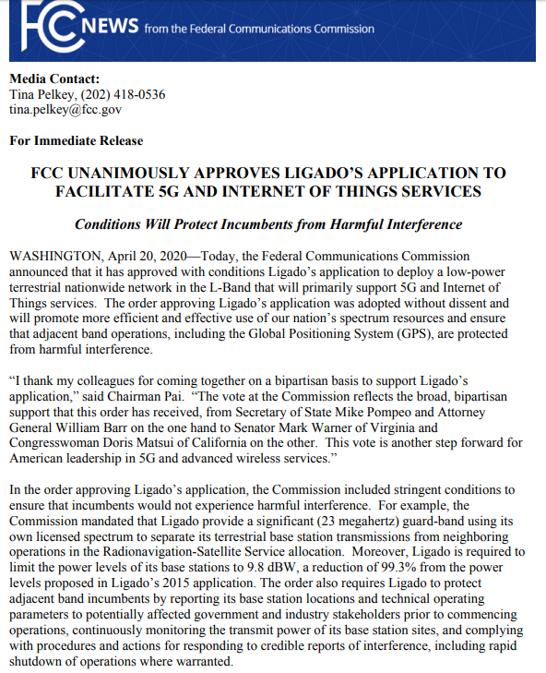
A Returning Topic
Ligado (formerly known as Light Squared)
  5G and IoT technologies
  Potential interference with GNSS
  Initial request in 2011-2012
  Again in 2015
  Most recent request (2020) was approved

Slide 15
FCC Conditions
…stringent conditions:
  Ligado provide a significant (23 megahertz) guard-band using its own licensed spectrum
  Ligado is required to limit the power levels of its base stations to 9.8 dBW, a reduction of 99.3%.
  Protect adjacent band incumbents by reporting its base station locations and technical operating parameters
  Continuously monitoring the transmit power of its base station sites
  Complying with procedures and actions for responding to credible reports of interference, including rapid shutdown of operations where warranted.

Slide 16
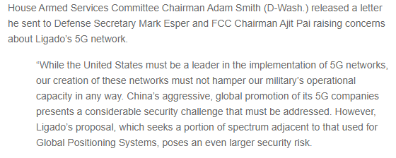
So all is well?
https://www.gpsworld.com/fcc-approves-ligado-broadband-network-dod-and-gps-industry-react/
Wait and see…

Slide 17
Questions?
mcpd@isu.edu
webekeit@isu.edu
giscenter@isu.edu

Slide 18
TWG Update
Elevation

Slide 19
New Data Map and Website!
Same stuff, only better!
  Available data with direct links
  Planned projects separate
Thanks to Keith Weber

Slide 20
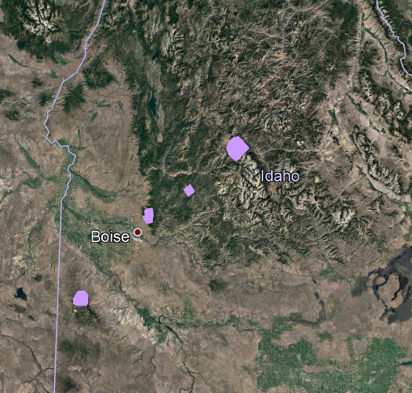
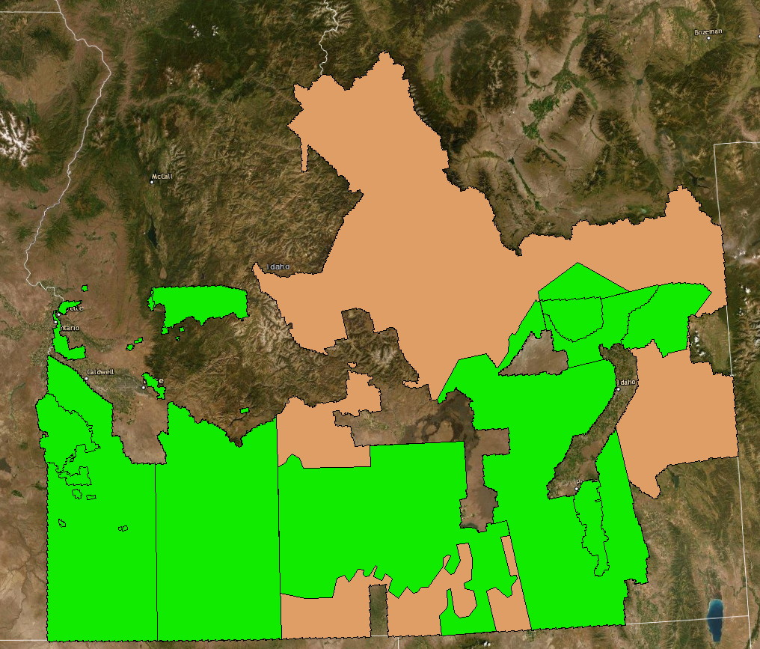

Newly Collected & Available Lidar Data
SnowEx (CRREL, QS) – thanks HP Marshall!
FEMA Southern ID
INL lidar – thanks Glenn Russell!
  Available soon!
Boise River – thanks
  Available soon!

Slide 21
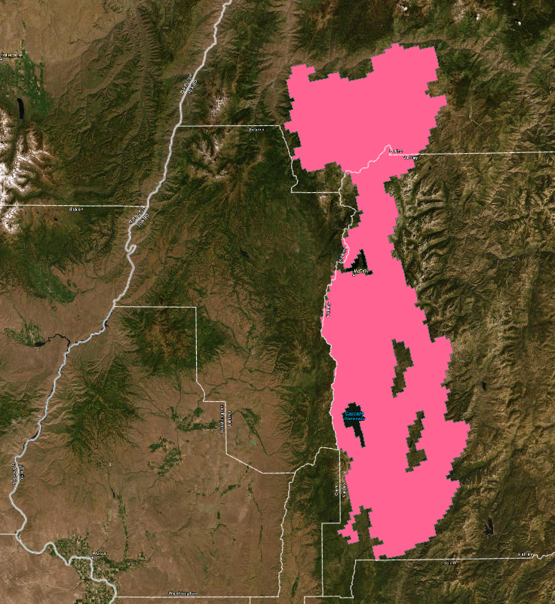
Upcoming, Planned, and Outstanding Data
Earthquake Epicenter
Adams County
Valley County
Teton County

Slide 22
Other Business

Slide 23
Adjourn
Next Meeting:
  IGC-EC Meeting - Thursday, July 16, 2020

