Slide 1
Idaho Geospatial Council – Executive Committee (IGC-EC)
July 16, 2020

Slide 2
Minutes
May 21, 2020

Slide 3
Changes at ITS
GIS Website
TWG Revitalization
GIS Strategic Plan

Slide 4

Refresher
GIS Plan * GIS website * Next Steps

Slide 5
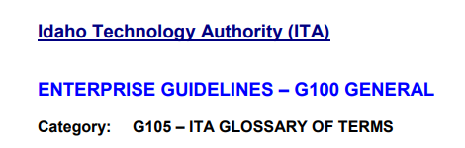
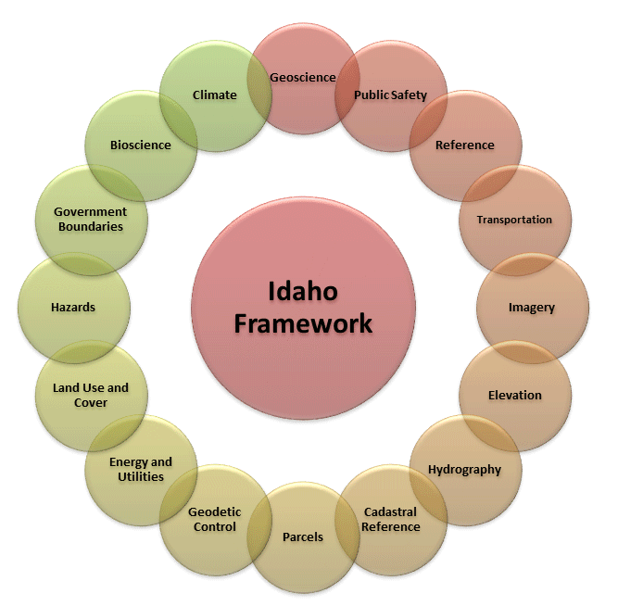
Some Basic Definitions
Framework Data Theme: Spatial data that is commonly needed by a wide spectrum of GIS users with a goal toward developing and maintaining coverage statewide.

Slide 6


Framework Data Theme
Framework Dataset: The GIS dataset representing all or a portion of a Framework Data Theme.
Framework: A framework dataset along with the technology, policies, standards, human resources, and related activities necessary to acquire, process, distribute, use, maintain, and preserve this spatial data. The Idaho Map (TIM) consists of a collection of frameworks.
The Idaho Map (TIM): The full collection of Framework Data Theme GIS datasets.
Spatial Data Infrastructure (SDI): The technology, policies, standards, human resources, and related activities necessary to acquire, process, distribute, use, maintain, and preserve spatial data.

Slide 7
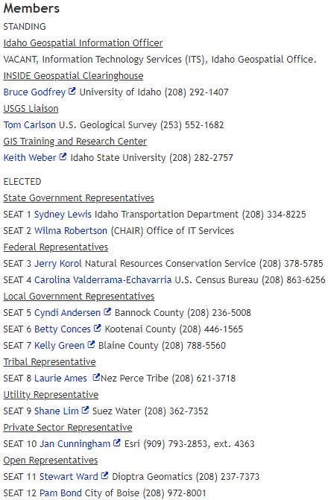
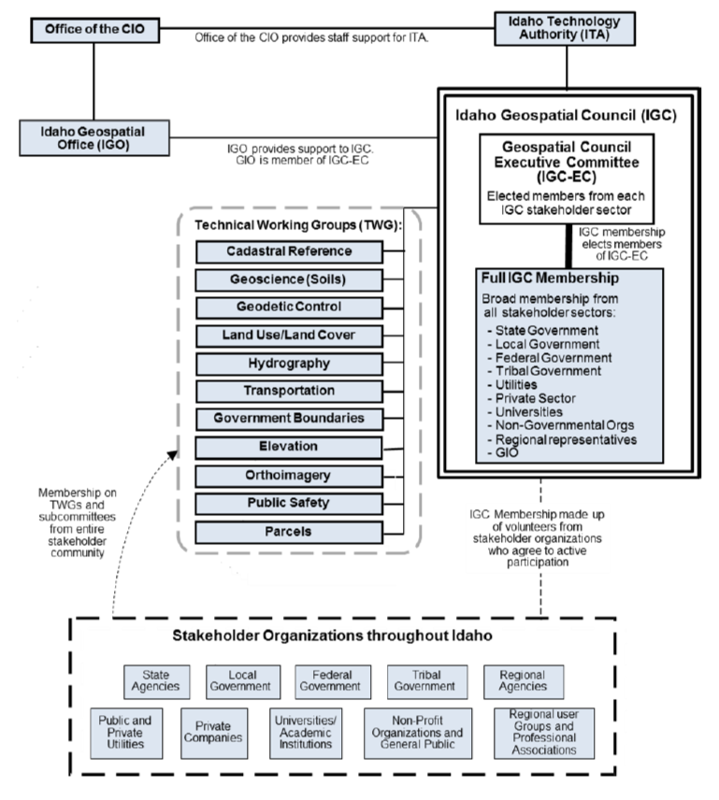
GOVERNANCE

Slide 8
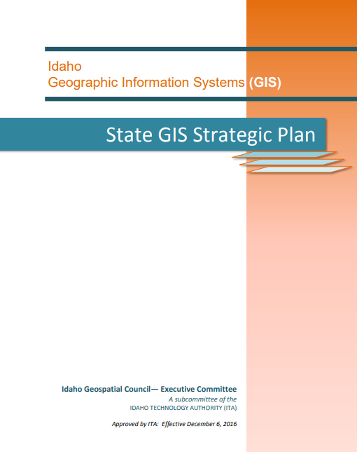
GIS PLAN
Vision: Idaho Spatial Data Infrastructure (Idaho SDI) is fully developed, maintained, and managed and supports the missions of Idaho organizations through easy access to high-quality, up-to-date geographic information and related services.
Mission: With leadership by state government and active participation from stakeholders statewide, we will develop, deploy and efficiently operate the Idaho SDI with a focus on meeting the geographic information needs of users and delivering real, substantial benefits to a comprehensive spectrum of organizations and individuals in Idaho.

Slide 9
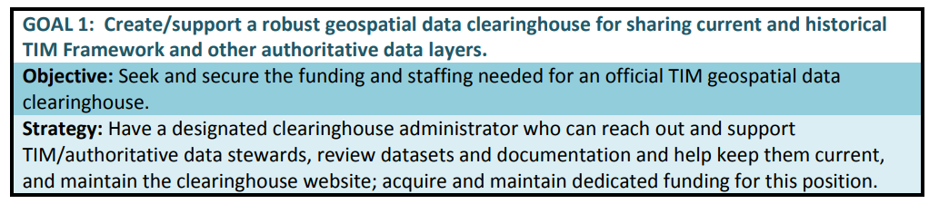
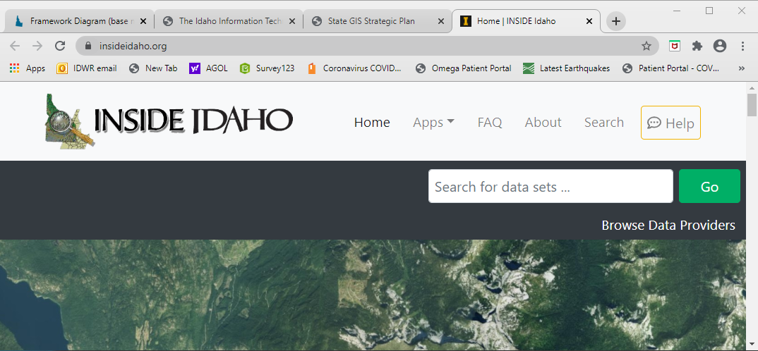
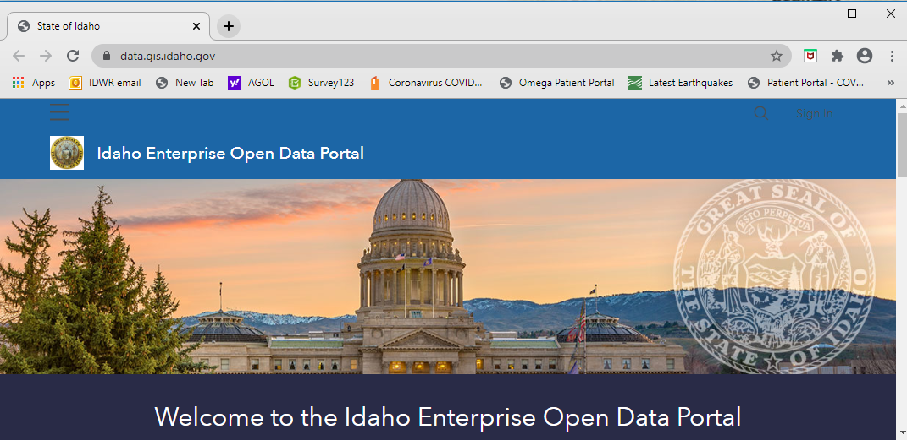
Strategic Goal 1 of 4

Slide 10
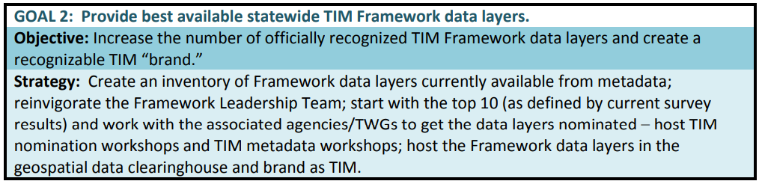
Strategic Goal 2 of 4
Priority Layers:
Orthoimagery (high resolution)
Parcels and Legal Lots
Transportation
Government Boundaries

Slide 11
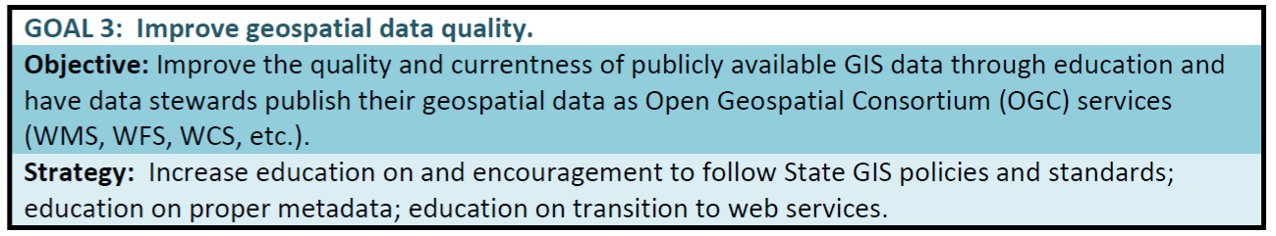
Strategic Goal 3 of 4

Slide 12
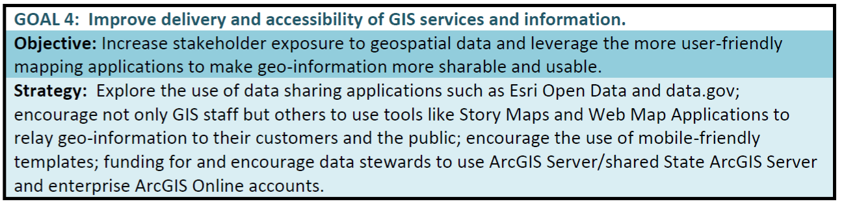
Strategic Goal 4 of 4

Slide 13
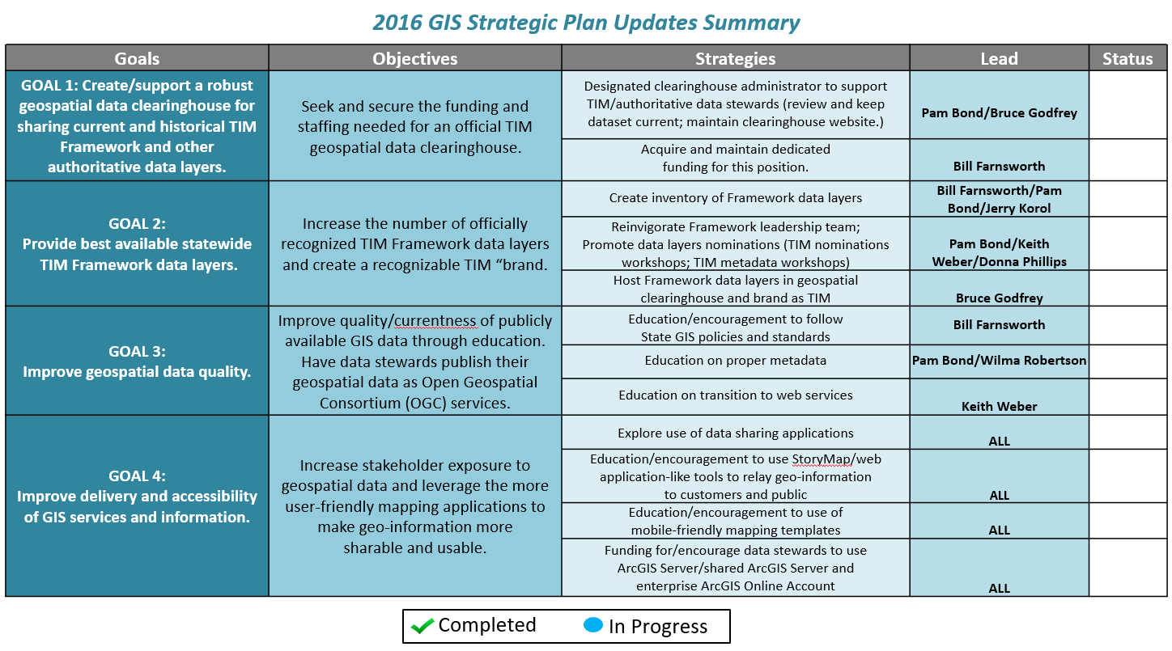


Slide 14
ACTION ITEMS – GOAL 1
Form subcommittee to look at:
How would maps.Idaho.gov and Inside Idaho complement each other?
Finally decide how Data Framework Layers are marked (TIM symbol?)
What are the funding needs and possible funding streams?
Other?

Slide 15
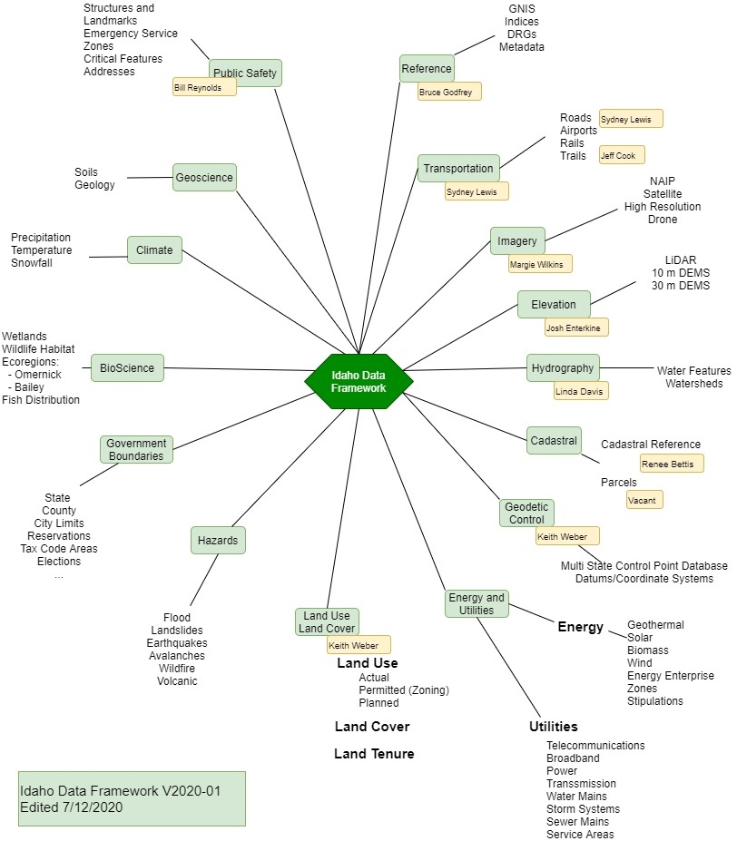
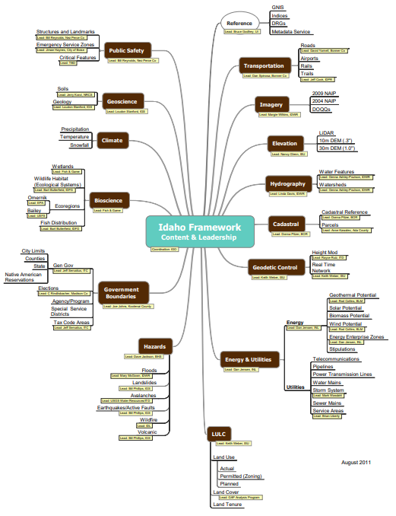

Slide 16
ACTION ITEMS – GOAL 2
Official Framework Layers
Emergency Service Zones
Parcel Data
Hydrography Data
Control Point
Idaho Land Cover
Structure and Landmarks
Active TWGS | Inactive TWGS
Transportation | Reference
Imagery | Cadastral Reference
Elevation | Parcels
Hydrography | Energy and Utilities
Geodetic Control | Land Use Land Cover
Public Safety | Hazards
 | Government Boundaries
 | Bioscience
 | Climate
 | GeoScience

Slide 17
Action Items?!
We need TWG leaders for:
Parcels
Energy and Utilities
Hazards
Government Boundaries
Bioscience
Climate
GeoScience
Re-energize:
Reference
Cadastral Reference
Land Use Land Cover
Which framework layers should be included in a data theme?
What should be the “official” for Idaho
Develop/review exchange standard
Develop/review stewardship plan

Slide 18
ACTION ITEMS – GOAL 3
Form subcommittee to develop plan / action items for this goal
Education and encouragement to follow State GIS Policies and Standards
Education on proper metadata
Education on the transition to web services

Slide 19
ACTION ITEMS – GOAL 4
Form subcommittee to develop plan / action items for this goal

Slide 20
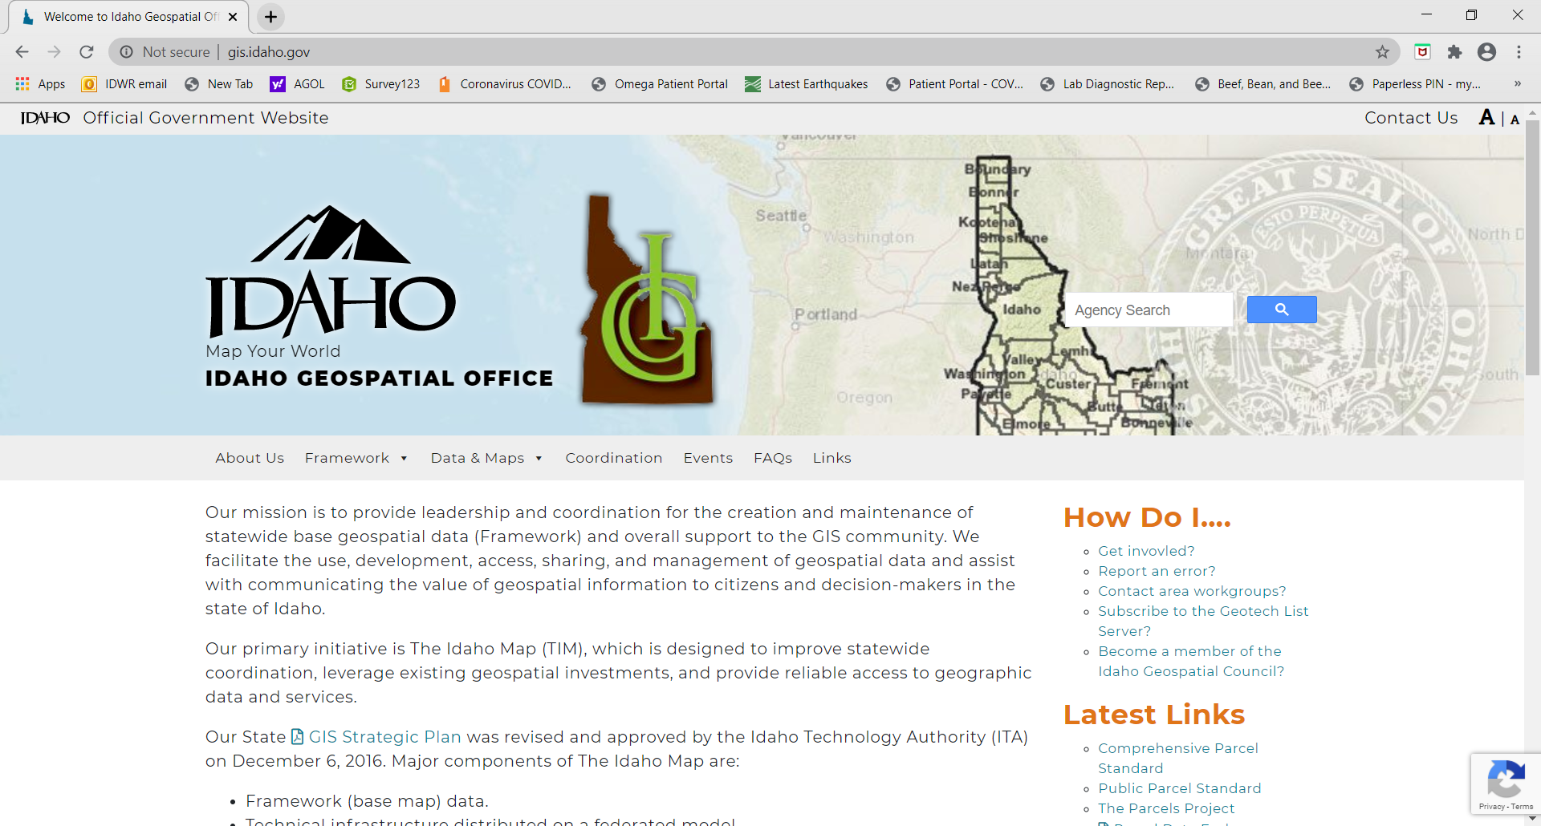
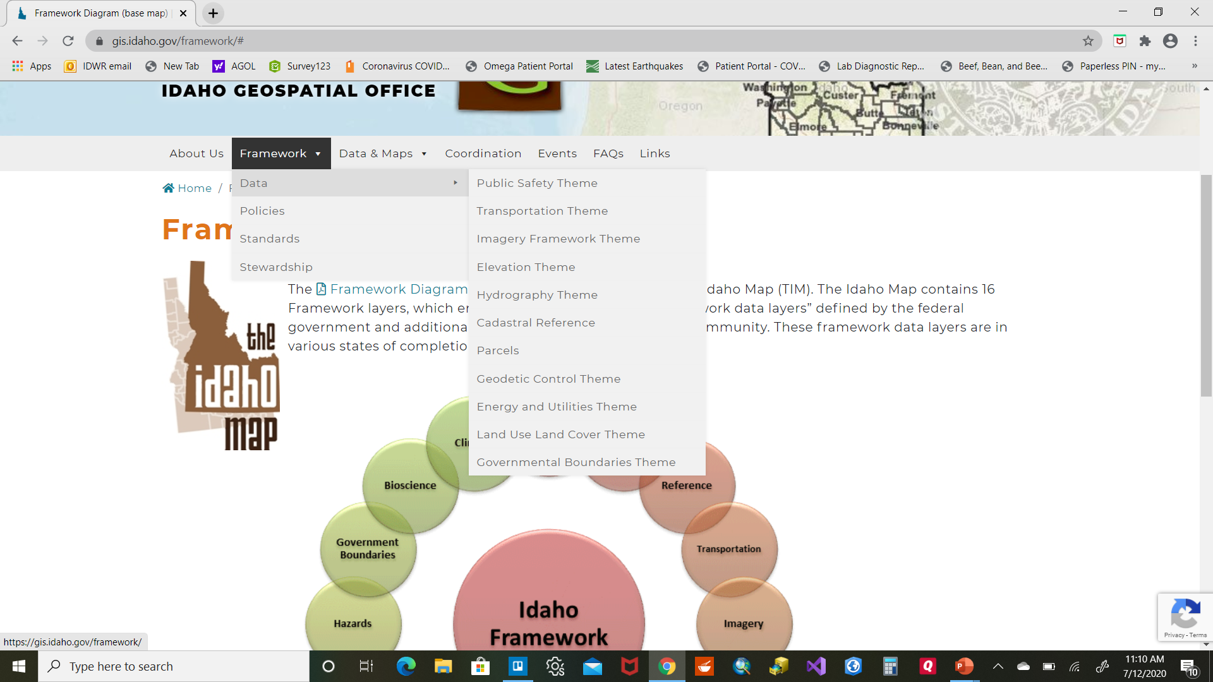
Refresh our gis.Idaho.gov website

Slide 21
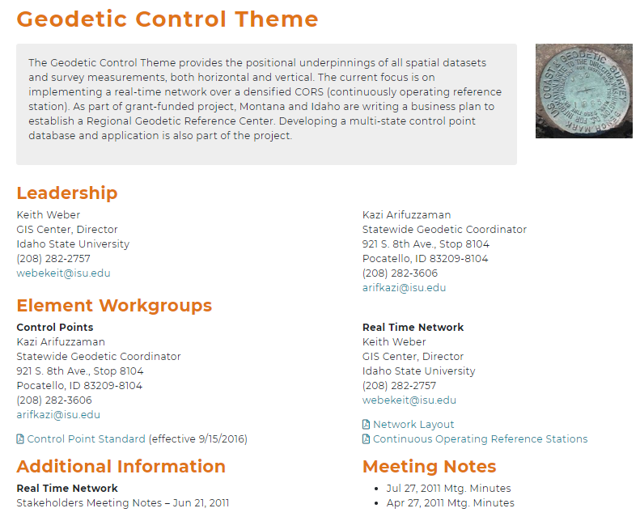
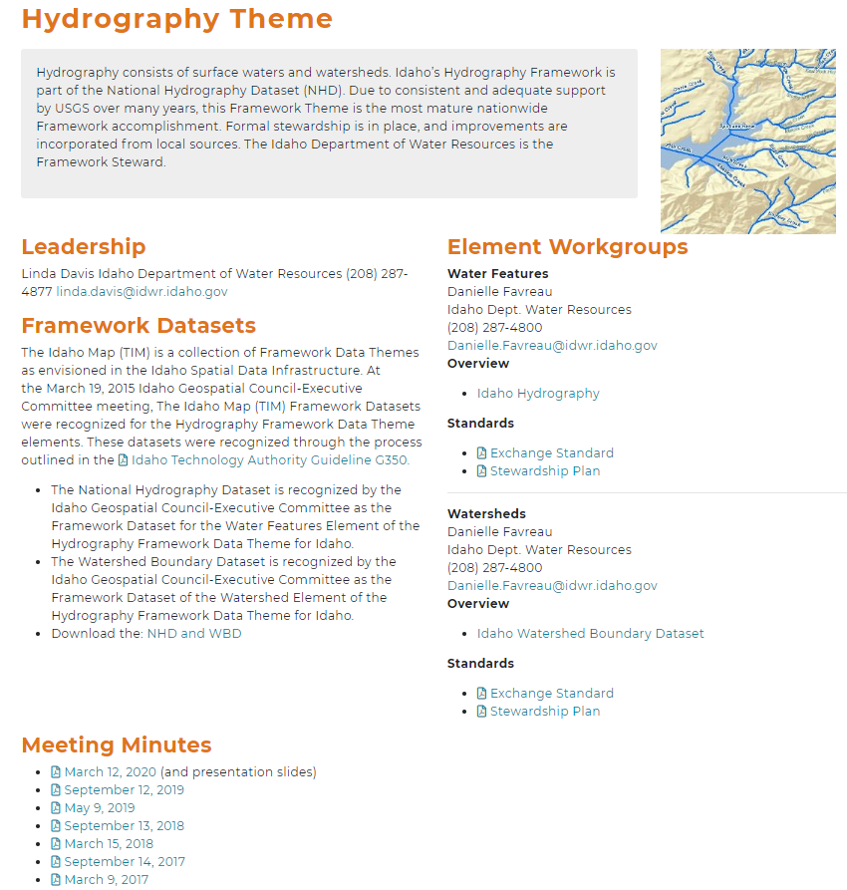
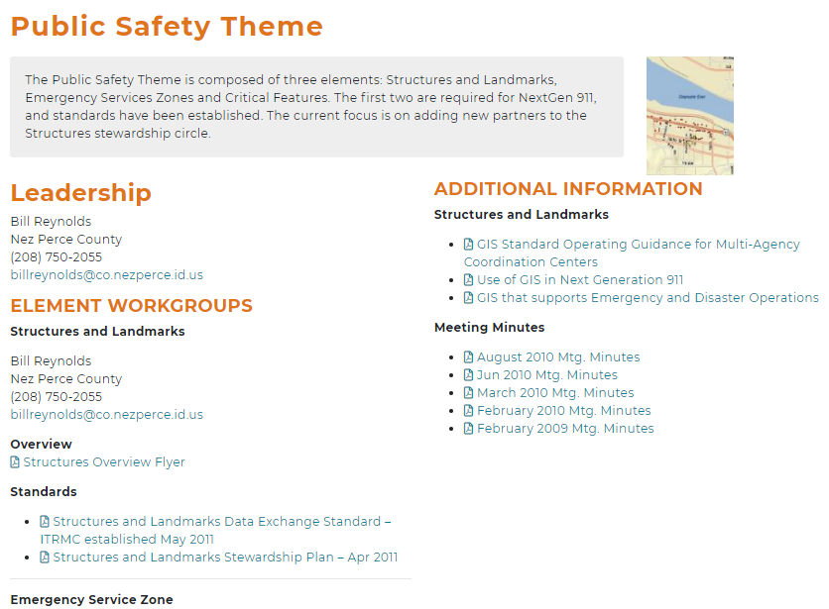
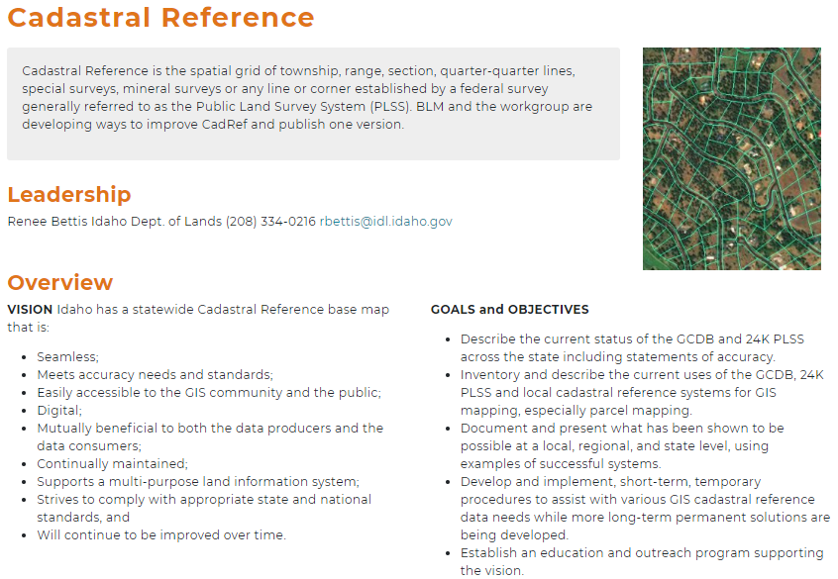
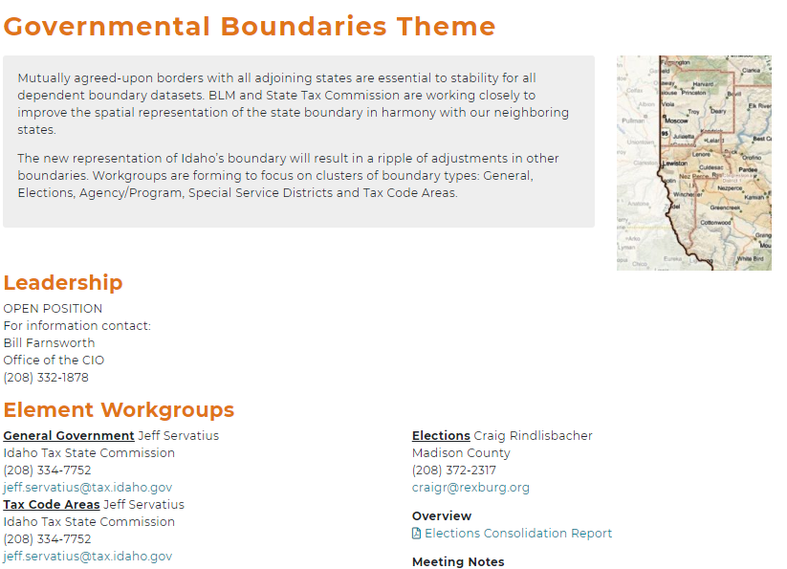
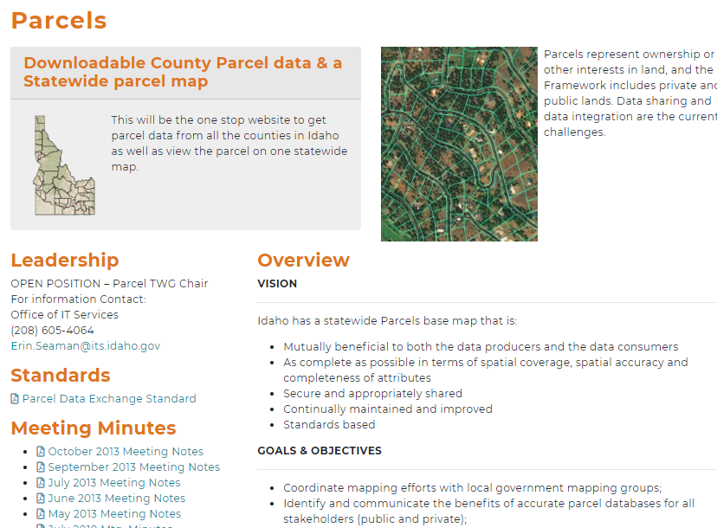
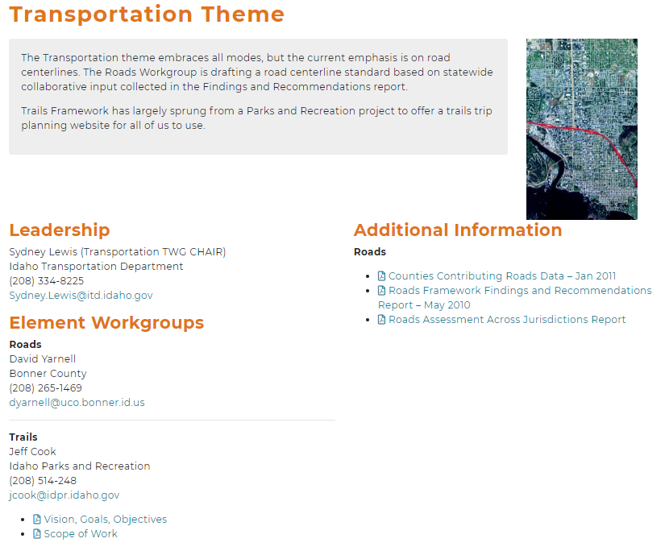
Please help to refresh those pages

Slide 22
Introduction of new Chief Data Officer/GIO
Mike Woodford

Slide 23
2020 Census Update
Partnership Specialist- Carolina Valderrama Echavarria
July 16, 2020

Slide 24



Self Response
The U.S. Census Bureau is monitoring coronavirus (COVID-19) carefully, and the health, safety and well-being of the public and our staff is our top priority.
Self-Response Phase – Revised Schedule March 12 – October 31
Group Quarters (E-Response & Paper Enumeration) April 2 – September 3
https://2020census.gov/en/news-events/operational-adjustments-covid-19.html

Slide 25
Nonresponse Followup (NRFU)
Update: Leave Idaho 100 % complete
1st state in the west to start Nonresponse Followup (NRFU)
Timeline start July 16 runs 7 weeks (first week September)
Training Enumerators
Enumerator operation will begin July 16 (with consideration to Covid guidelines)
Notices left on doors if no answer on how to complete Census Survey.

Slide 26
Multiple sources to encourage participation/reminders
NRFU (enumerators starting July 16th)
PO Box Fliers going out to notify folks (15,349 sent out last week of June)
6th mailer sent to households ( not previously planned prior to covid - sent out this week)

Slide 27
Mobile Questionnaire Assistants (MQAs)
Where:
Deployed to bottom 20% tracts in the state.
Example: gas stations/ grocery stores
Covid conditions has paused this operation in certain counties (suspension list weekly)
What:
Table with Census staff to encourage participation with smartphones or intake questionnaire.
Staff will social distance
Partnerships Specialists working with the Area Census Office (ACO)

Slide 28
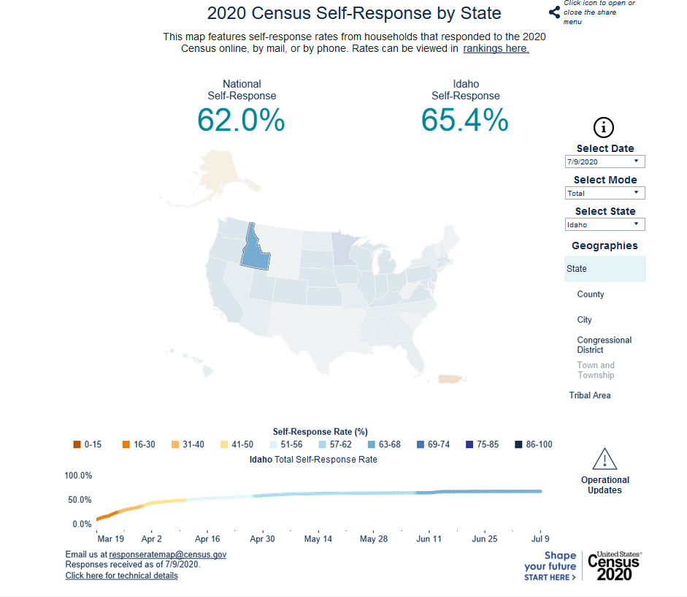

Slide 29
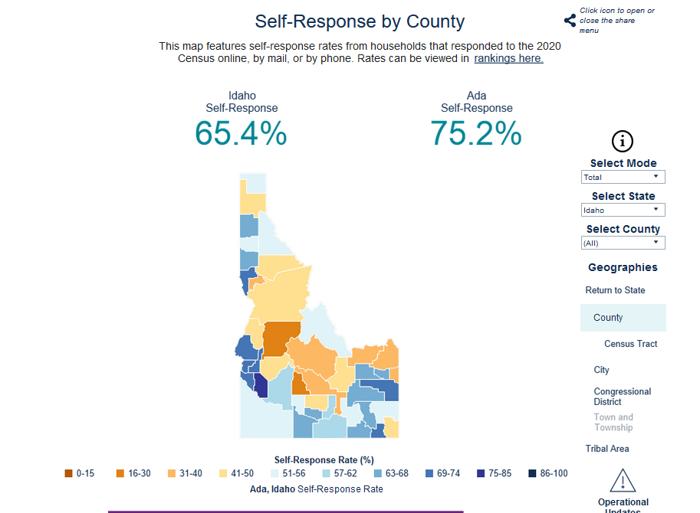

Slide 30
Thank you!
Carolina Valderrama Echavarria
Carolina.valderrama.echava@2020census.gov
208-863-6256
Response Map:
https://2020census.gov/en/response-rates.html

Slide 31
ITA Report
June 3, 2020 Meeting

Slide 32
Items discussed during ITA Meeting
Ethics and Conduct Policy Passed
IGC-EC Election Results Ratified
ITLC is losing members because IT has been moved to ITS
Phase 2 modernization update:
ITS staff up from 66 to 135
Number of customers supporting up from 1,800 to 6,000
New positions and functionality : Chief Technology Officer, Enterprise Architect, Enterprise licensing, Portfolio Management, Data management/analytics and sharing, Project delivery team and Regional Support Centers.

Slide 33
TWG Update
Geodetic Control

Slide 34
Other Business

Slide 35
Adjourn
Next Meeting:
IGC-EC Meeting - Thursday, Sept. 17, 2020

